Slide 1


















eMBB
HD Video Uploading
Extended Reality
Digital Twins
Immersive Cloud XR
Holographic Communication
UCBC
RTBC
5.5G to 6G
eMBB & CAeC & RTBC
Machine Vision
5.5G: Huawei’s Vision
Holographic Communication
eMBB
CAeC
mMTC
URLLC
RTBC
Positioning
Vehicle-to-Everything
UCBC
URLLC
HCS
6G Vision
5G to 5.5G
COC
eMBB
EDuRLLC
mMTC
HCS
Gigabytes in a Second
3D Video, UHD Screens
Smart Home/Building
Work and Play in the Cloud
Augmented Reality
mMTC & COC & UCBC
URLLC & EDuRLLC & HCS
Voice
Industry Automation
Federated Learning
Native AI Network
Machine Vision
Industry 4.0
Network Sensing
Autonomous Driving
Mission Critical Application
Smart City
Self Driving Car
5G IMT 2020
mMTC
URLLC

Slide 2
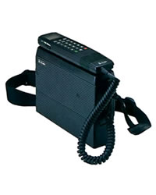
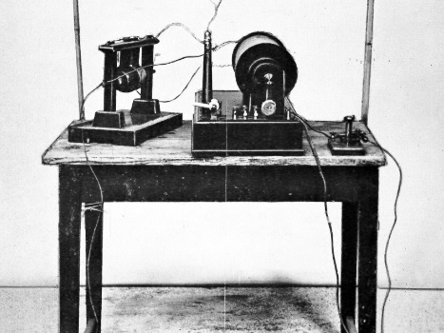

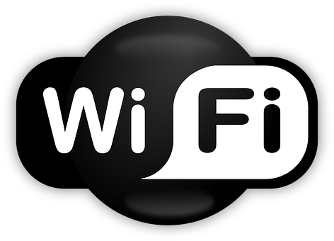



1896
1962
1979
1999
2002
2016
2020
Wireless Telegraph
Guglielmo Marconi developed the first wireless telegraph system
Satellite Communication
The first communication satellite, Telstar, was
launched into orbit
Cellular Network
The first commercial cellular network was launched in Tokyo
WiFi
IEEE 802.11b standard was released
Bluetooth
IEEE 802.15.1-2002 standard was released
NB-IoT
3GPP R13 completed the NB-IoT standardization
Federated Learning
3GPP R17 approved
the FL technology standard

Slide 3


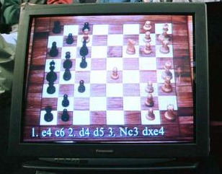
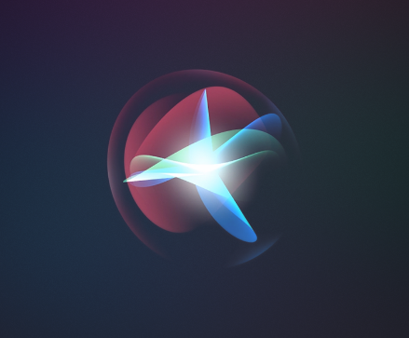
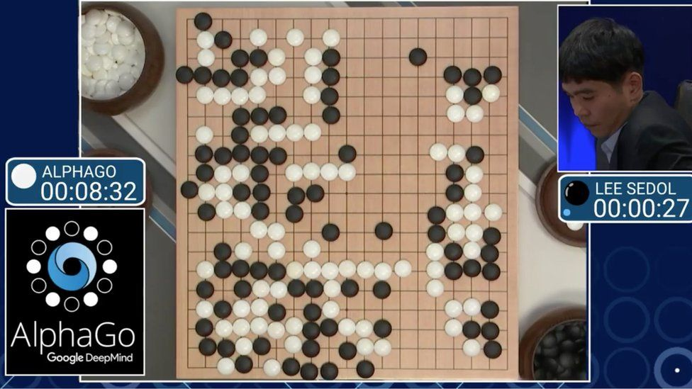

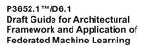
1950
1955
1997
2011
2017
2021
Turing Test
Alan Turing proposed a test for machine intelligence
Artificial Intelligence
John Macarthy coined the term “artificial intelligence”
Deep Blue
Deep Blue from IBM defeated word chess champion
Siri
Apple integrated Siri (a voice interface) into iPhone 4s
AlphaGo
Google’s AlphaGo defeated world champion in Go game
Federated Learning
IEEE 3652.1-2020 released FL standard (initiated by WeBank)

Slide 4







Edge Inference
Architectures
Platforms
Enabling wireless techniques (e.g., AirComp, RIS) for edge training (e.g., FL)
“Learning to optimize” resource allocation for edge AI systems
Autonomous driving
AIoT, IIoT
Smart healthcare
IEEE FL standards
ETSI MEC standards
Task-oriented communication for edge inference
A holistic end-to-end architecture for edge AI systems
Software: TensorFlow Federated, FedML
Hardware: FPGA, GPU, TPU
Edge Training
Service-Driven Resource Allocation
Standardizations
Applications

Slide 5



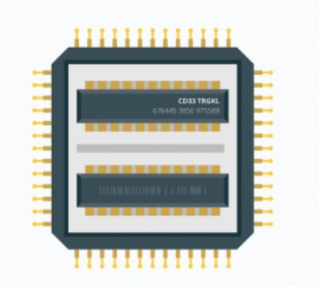





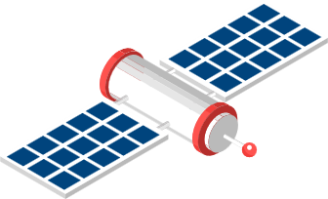


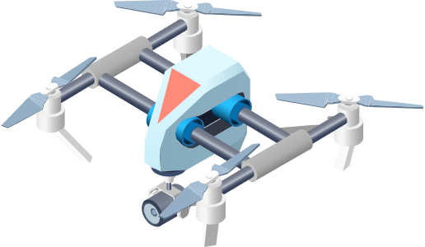

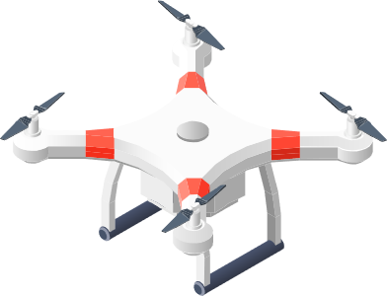
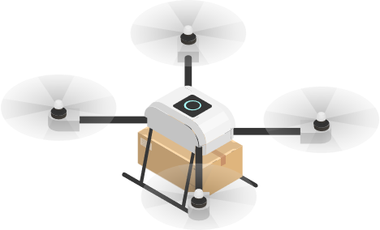







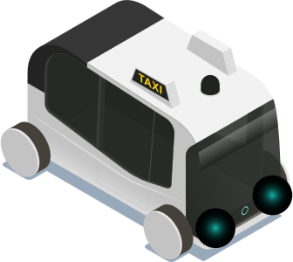
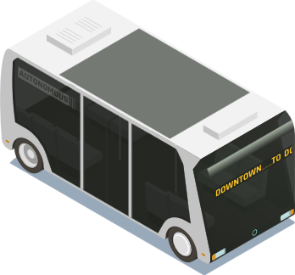

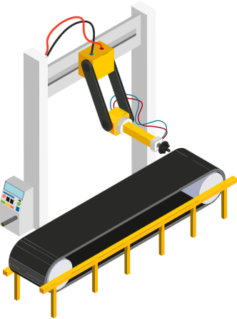
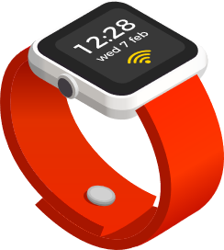








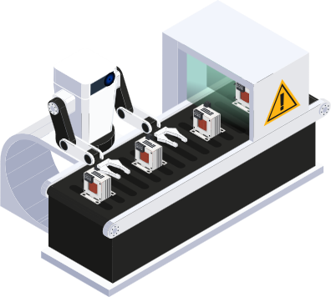
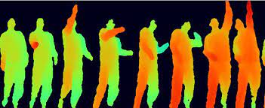


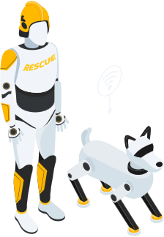
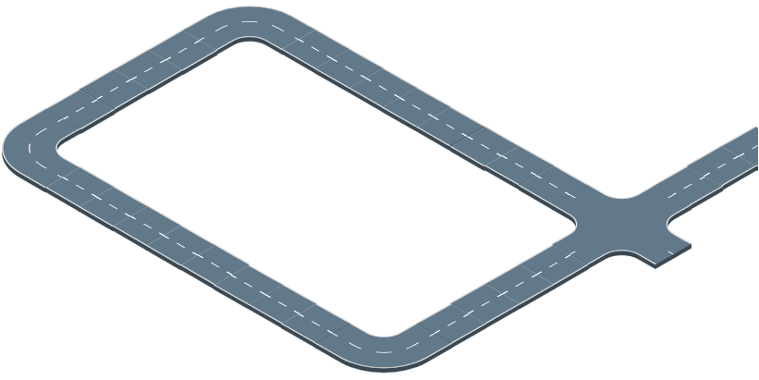

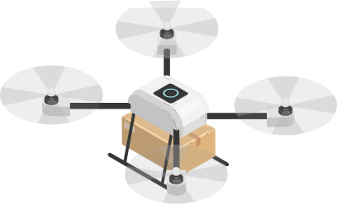

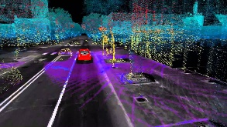





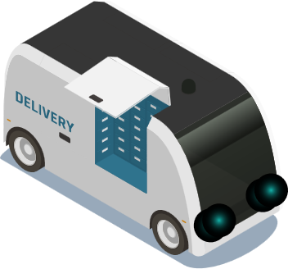










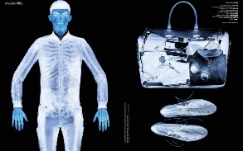



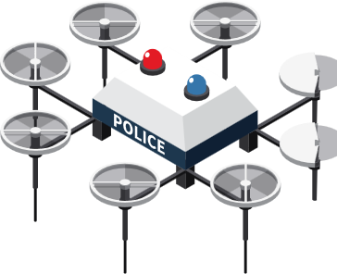
Data
AI-Native
Transmitters
Hardware
Wireless
Environment
Cloud Intelligence
Speech
Signals
Tasks
Core Network
Hardware
AI-Native
Receiver
Image
Data
Sematic Communication
Image Retrieval
Edge Intelligence
Tactile Recognition
Haptic
Information
Sub-6 GHz
mmWave
THz
Optical
On-Device Intelligence
AI-Native Communication
Connected Intelligence
Communication Signal
Industrial IoT
Sensing Signal
Gesture and Activity Recognition
Smart Healthcare
Simultaneous Localization and Mapping
Autonomous Driving
Augmented Human Sense
Network Sensing
Application Scenarios

Slide 6











模型聚合
边缘服务器
上传本地模型
设备选择
广播全局模型
设备1
设备2
设备K

Slide 7





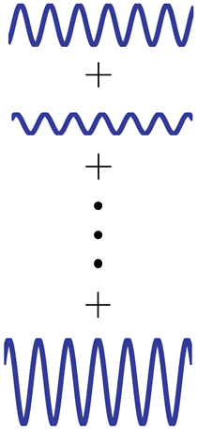


功率控制
波形叠加

Slide 8

Consensus Model Aggregation
Device
Model Exchange
Device
Device
Device

Slide 9
Model Parameter Blocks Aggregation
Server
Upload Model Parameter Blocks
Broadcast Whole Model Parameters
Device
Device
Device

Slide 10

Agent
Agent
Model Exchange
Agent
Agent
Agent
Observations
Dynamic Environment

Slide 11





Secure Model Aggregation
Server
Upload Encoded
Local Models
Broadcast
Global Model
Devices
Malicious Devices
Colluding Devices

Slide 12

波形叠加
边缘服务器
设备
设备
设备

Slide 13
Waveform Superposition
Edge Server
Device
Device
Device

Slide 14


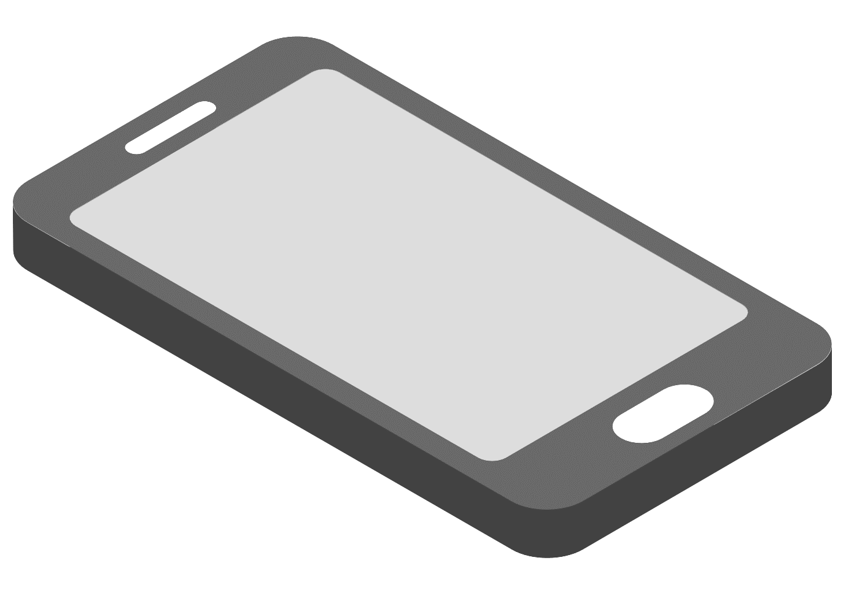
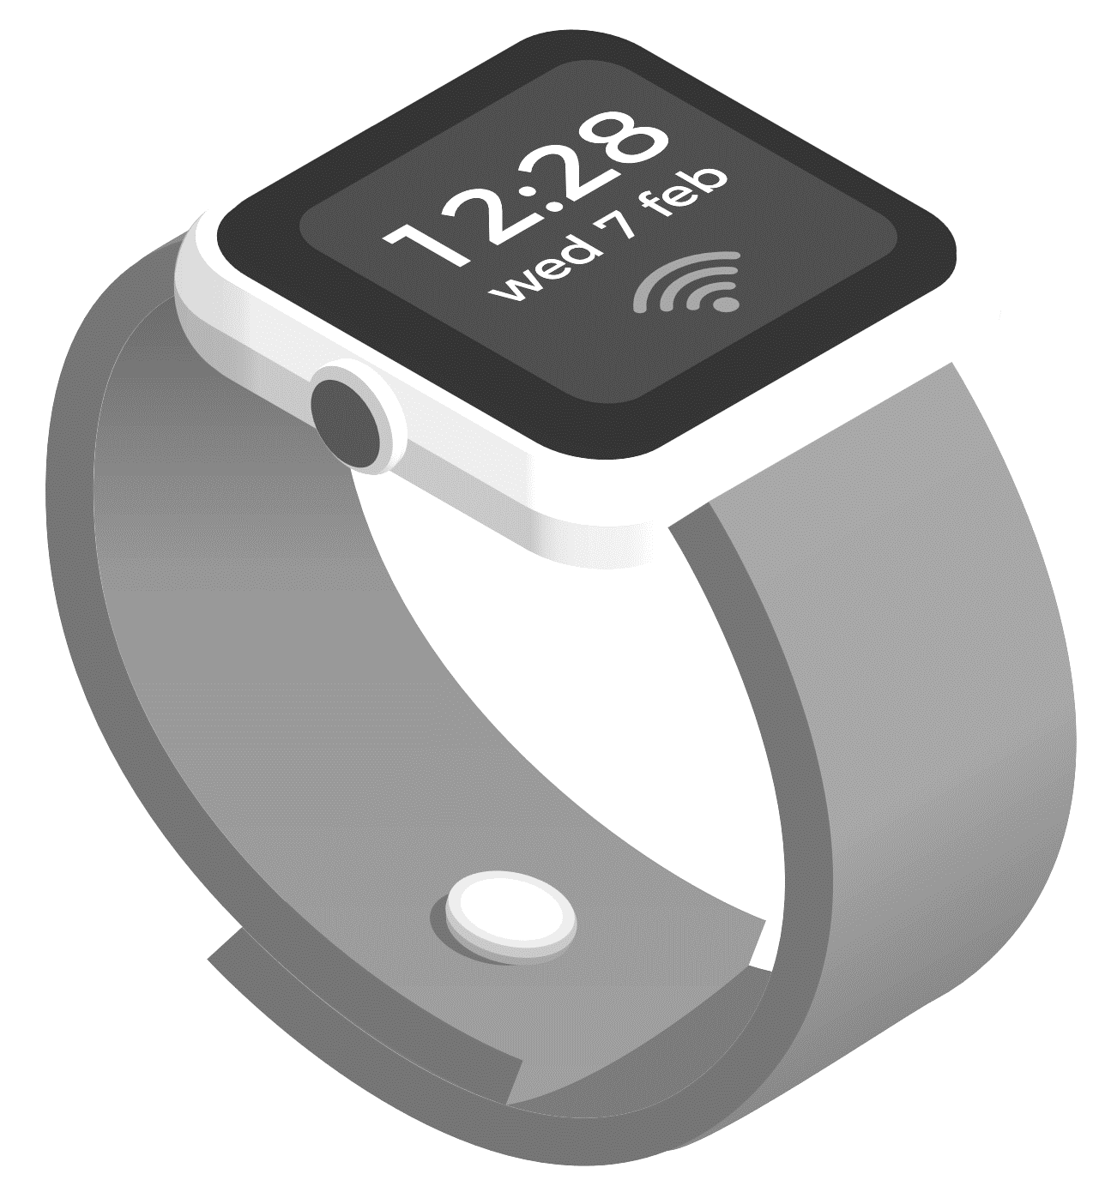



Active Device
Inactive Device
Edge Server

Slide 15


Fronthaul Links
Uplink Channels
Server
Device
Access Point

Slide 16


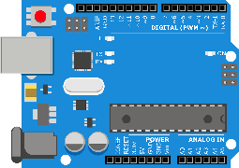
Edge Server
Reflecting Link
RIS
Blocked Links
RIS Controller
Device
Device
Device

Slide 17




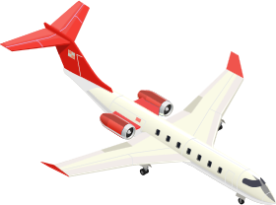

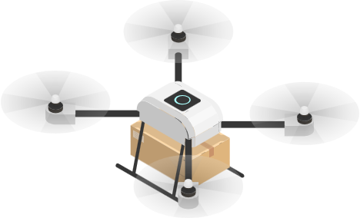
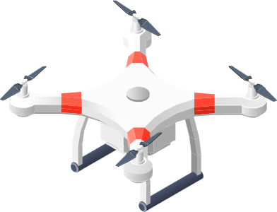
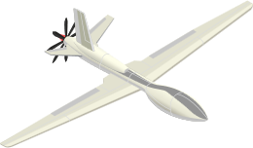






Space Network
Air Network
Ground Network

Slide 18
D2D Wireless Communication Links
Communication Coverage
Source Devices
Destination Device

Slide 19
Uplink
Downlink
Edge Servers
Cooperative Transmission
Input Data Offloading
Inference Result
Device
Device
Device

Slide 20

Inference
Edge Server
Corrupted
Feature Vector
Noise
Wireless Channel
Encoded
Feature Vector
Device
JSCC Encoder
Raw
Feature Vector

Slide 21
Edge Server
Mixed Features
Intermediate Features
Device
Device
Device
Device

Slide 22
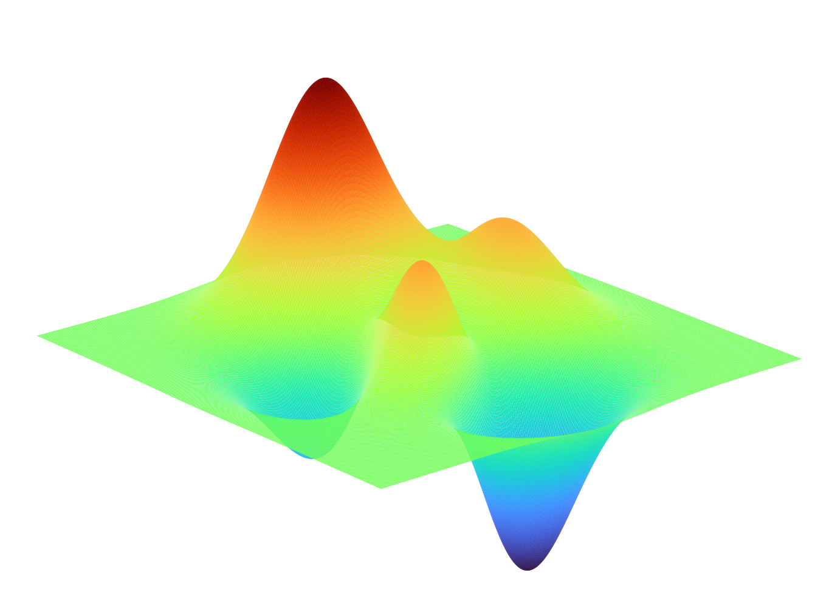



Theory-Driven Method
Problem Instance
Optimal Solution
Data-Driven Approach

Slide 23
Operation & Apps
Edge AI Management & Orchestration
AI Services
AI Models
Planning
Deployment
Maintenance
Optimization
Monitoring
AI Workflow
Edge Network Function
Data Governance
Multi-Party, Multi-Domain
CP
UP
CmP
CP
UP
CmP
Converged computing and communication at
the edge
Data Collection
Data Storage
RCN
RCN
Data Processing
Data Provisioning
Network Infrastructure

Slide 24
Communication Signal
AI-Native
Transmitters
Sensing Signal
Data
Hardware
Wireless
Environment
Cloud Intelligence
Speech
Signals
Tasks
Core Network
Gesture and Activity Recognition
AI-Native
Receiver
Hardware
Image
Data
Sematic Communication
Simultaneous Localization and Mapping
Image Retrieval
Edge Intelligence
Tactile Recognition
Haptic
Information
Sub-6 GHz
mmWave
THz
Optical
Augmented Human Sense
On-Device Intelligence
Network Sensing
AI-Native Communication
Device-Edge-Cloud Computing

